Slide 1

STATS 293 Applied Statistics with R
Chapter 4 – Randomised Block Designs

Slide 2
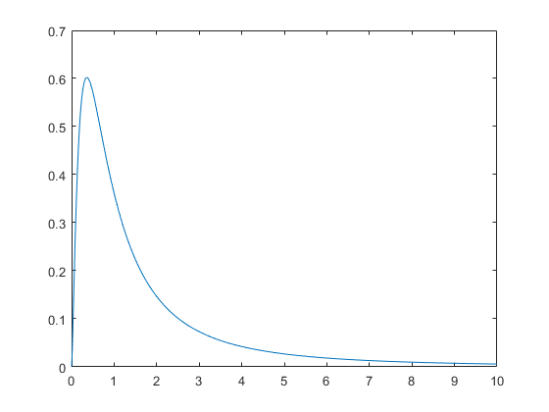


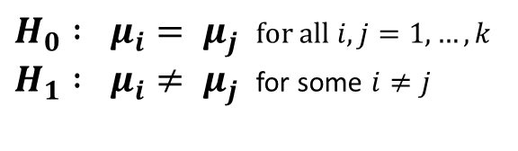
Preamble
Preamble:
We want to test the hypothesis that the means of all the groups are equal, i.e.
Suppose that we have a total of i = 1, …, k population groups that are…
Independent
Normally distributed
Have equal variance σ²
ANOVA Conditions:
$H_{0} : μ_{i}= μ_{j}$ for all $i,j=1, …, k$ $H_{1} : μ_{i}≠ μ_{j}$ for some $i≠j$
To test between H₀ and H₁ we calculate the F-statistic for one-way ANOVA:
$$F ≡ \frac{MST}{MSE} = \frac{{SST }/{ \left(k−1\right)}}{{SSE }/{ k \left(n−1\right)}}$$
If the ANOVA conditions are satisfied then $F \sim F_{k−1, N −k}$. We look to see where F_{obs} lies in the distribution of F _{k-1 , N-k} The p-value $P\left( F≥F_{obs} \right)$ gives a measure of evidence against H_{0.}
$$F_{obs}$$
$$P(F≥F_{obs})$$
2

Slide 3

Preamble
Preamble:
We want to test the hypothesis that the means of all the groups are equal, i.e.
Suppose that we have a total of i = 1, …, k population groups that are…
Independent
Normally distributed
Have equal variance σ²
ANOVA Conditions:
$H_{0} : μ_{i}= μ_{j}$ for all $i,j=1, …, k$ $H_{1} : μ_{i}≠ μ_{j}$ for some $i≠j$
To test between H₀ and H₁ we calculate the F-statistic for one-way ANOVA:
$$F ≡ \frac{MST}{MSE} = \frac{{SST }/{ \left(k−1\right)}}{{SSE }/{ k \left(n−1\right)}}$$
If the ANOVA conditions are satisfied then $F \sim F_{k−1, N −k}$. We look to see where F_{obs} lies in the distribution of F _{k-1 , N-k} The p-value $P\left( F≥F_{obs} \right)$ gives a measure of evidence against H_{0.}
If we can do something that makes the MSE smaller, this will make the F-Statistic bigger.
=> The p-value of the test will be smaller => We will have more evidence against the H_{0.}
$$F_{obs}$$
$$P(F≥F_{obs})$$
By making the MSE smaller we increase the power of our test.
3

Slide 4

4.1 – Nuisance Variables

Slide 5
4.1 – Nuisance Variables
4.1a – Nuisance Variables:
When we test the effect of a factor on a response variable, Y say, there are often other factors that lead to variability in Y. When these other variables are not of interest to us they are referred to as nuisance variables.
Example 1:
The Ministry of Social Development offers various ‘back-to-work’ programs (CM, ICSX, JSWR) to help get people who have been unemployed for long periods back into the labour market. Is there a difference in the effectiveness of these programs?
Response Variable Time from starting the program to finding work
Treatment Factor Work program
Treatment Levels CM, ICSX, JSWR
Nuisance Variables Age, Education, # Dependent Children,
Criminal Record History, Employment History
5

Slide 6
4.1 – Nuisance Variables
4.1a – Nuisance Variables:
When we test the effect of a factor on a response variable, Y say, there are often other factors that lead to variability in Y. When these other variables are not of interest to us they are referred to as nuisance variables.
Example 2:
Heart operations are graded on their degree of success (1= patient dies, 10 = patient makes full recovery after 1 year). The Ministry of Health is interested whether there is any difference in the average grade of operations at 5 different hospitals across the North Island.
Response Variable Surgical grading
Treatment Factor Hospital
Treatment Levels Hospital 1, Hospital 2, Hospital 3, Hospital 4, Hospital 5
Nuisance Variables Severity of patient condition, other underlying health conditions of patient, smoking status, health of local population
6

Slide 7
4.1 – Nuisance Variables
4.1a – Nuisance Variables:
When we test the effect of a factor on a response variable, Y say, there are often other factors that lead to variability in Y. When these other variables are not of interest to us they are referred to as nuisance variables.
Example 3:
A study is undertaken to determine whether there is any difference in the ability of two prescription drugs (Atorvastatin and Pravastatin) to reduce the level of cholesterol in the blood stream of patients.
Response Variable Cholesterol level
Treatment Factor Prescription drug
Treatment Levels Atorvastatin, Pravastatin
Nuisance Variables Age, Gender, Exercise Levels, Diet of participants
7

Slide 8
4.1 – Nuisance Variables
4.1b – Dealing with Nuisance Variables:
Method 1 – Completely Randomised Designs
In a CRD participants are assigned to treatment levels completely at random. The idea here is that (with a large enough sample size) the nuisance variables will be uniformly distributed across treatments so their effect is somewhat negated.
The major drawback is that all the variation in the response variable caused by the nuisance variable will be accumulated in the MSE. A large MSE, relative to the MST for the factor of interest, decreases our power to detect factor effects.
Method 2 – Hold Nuisance Factors Constant
In the context of Example 3 (Cholesterol Study), we could attempt to negate the effects of the nuisance variables by allowing only females aged 18-30 within similar diet and exercise regimes into the study.
The first drawback here is that this makes it hard to generalise results. Whilst Atorvastatin may be better than Pravastatin at reducing cholesterol for females aged 18-30 within good diet and exercise levels, this may not be true for males aged 65+ with poor diet and exercise levels.
Secondly, the more nuisance variables you try and control for in this way, the smaller the pool of eligible participants for your study. This may result in insufficient sample sizes.
8

Slide 9
4.1 – Nuisance Variables
4.1b – Dealing with Nuisance Variables:
A much better way to deal with nuisance variables is to apply the concept of ‘Blocking’ within your experimental design...
9

Slide 10
4.2 – Blocking

Slide 11
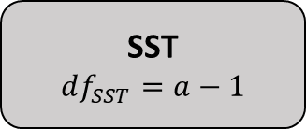
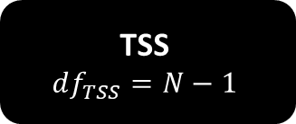
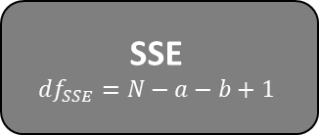
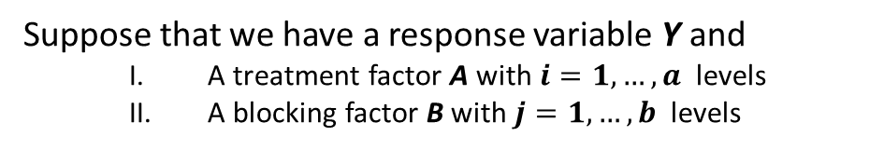
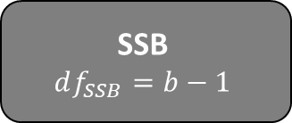

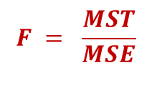
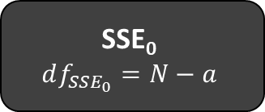
4.2 – Blocking
4.2a – Blocking:
The general idea of blocking is to include the nuisance variables as factors within the study. Any variable that causes variation in the response variable, but which is not of primary interest, can be used as a blocking variable.
In Stat 293 we will consider at most one blocking variable.
Sums of Squares Decomposition
There are two common types of blocking factor
Variables associated with gender, age, income, education levels etc. of participants.
Variables associated to the experimental setting, e.g. time of day, batch, location, DOW
$$F = \frac{MST}{MSE}$$
TSS
$$df_{TSS}=N−1$$
Suppose that we have a response variable Y and
A treatment factor A with $i=1, …, a$ levels
A blocking factor B with $j=1, …, b$ levels
SST
$$df_{SST}=a−1$$
SSE₀
$$df_{SSE_{0}}=N−a$$
By including the blocking factor in the design we capture the variability it causes in Y through the sums of squares for the blocking factor (SSB).
SST
$$df_{SST}=a−1$$
SSB
$$df_{SSB}=b−1$$
SSE
$$df_{SSE}=N−a−b+1$$
This reduces the SSE for the model compared to a non-blocked design and hence increases our power to detect factor effects.
11
Note that $N−1 −\left(a−1\right)−\left(b−1\right)=N −a −b+1$

Slide 12
4.2 – Blocking
4.2a – Blocking:
Instead of randomly allocating treatments over all experimental units (as in a CRD), more power is obtained by first grouping the units into blocks of relatively homogenous groups and then allocating the treatment randomly within each block.
Although there are many sorts of block designs, the most common is to have one and only one instance of each treatment within each block (non-replicated design). For example, a study containing 3 treatments would have blocks of 3 experimental units with each unit being assigned one of the 3 treatments at random.
Example: A study is to be conducted to determine if three prescription drugs (A, B & C) have any effect on the blood-sugar levels of diabetic patients. It is known that blood-sugar levels are affected by a patients diet (i.e. diet is a nuisance variable). A total of 12 study participants are recruited and are ranked on the basis of the quality of their diets and put into one of four blocks (poor diet, below avg diet, above avg diet, excellent diet).
Poor Diet
Below Avg Diet
Above Avg Diet
Excellent Diet
In a CRD participants are allocated at random to one of the three treatments (A, B or C)
A
A
C
A
A
B
C
B
B
B
C
C
In a RBD treatments are allocated at random within each block
A
C
B
C
B
A
A
B
C
B
A
C
12

Slide 13
4.2 – Blocking
4.2a – Blocking:
When there are multiple instances of each treatment in the same block this is known as a replicated design.
Example: A study is to be conducted to determine if three prescription drugs (A, B & C) have any effect on the blood-sugar levels of diabetic patients. It is known that blood-sugar levels are affected by a patients diet (i.e. diet is a nuisance variable). A total of 36 study participants are recruited and are ranked on the basis of the quality of their diets and put into one of four blocks (poor diet, below avg diet, above avg diet, excellent diet).
Poor Diet
Below Avg Diet
Above Avg Diet
Excellent Diet
In a CRD participants are allocated at random to one of the three treatments (A, B or C)
A
A
C
A
A
B
C
B
B
B
C
C
C
B
C
A
C
C
B
C
B
A
B
A
C
A
B
B
A
A
C
A
A
B
C
B
In a RBD treatments are allocated at random within each block
A
C
B
C
B
A
A
B
C
B
A
C
B
A
C
B
C
A
A
C
B
A
C
B
C
B
A
A
C
B
B
A
C
B
C
A
13

Slide 14
4.2 – Blocking
4.2a – Blocking:
Example:
A study is undertaken to determine whether there is any difference in the ability of two prescription drugs (Atorvastatin and Pravastatin) to reduce the level of cholesterol in the blood stream of patients.
Since cholesterol levels are known to increase with age, the age of study participants is a nuisance variable.
To control for this a randomised block design (RBD) is to be employed. 20 study participants have been obtained from each of the following 5 age groups:
18-30 31-40 41-50 51-65 65+
Randomly assign participants one of the two treatments within each of the groups.
14

Slide 15
4.3 – Fixed Effects Model

Slide 16
Recap of Last Lecture
Recap of Last Lecture:
We want to test the hypothesis that the means of all the groups are equal, i.e.
Suppose that we have a total of i = 1, …, k population groups that are…
Independent
Normally distributed
Have equal variance σ²
ANOVA Conditions:
$H_{0} : μ_{i}= μ_{j}$ for all $i,j=1, …, k$ $H_{1} : μ_{i}≠ μ_{j}$ for some $i≠j$
To test between H₀ and H₁ we calculate the F-statistic for one-way ANOVA:
$$F ≡ \frac{MST}{MSE} = \frac{{SST }/{ \left(k−1\right)}}{{SSE }/{ k \left(n−1\right)}}$$
If the ANOVA conditions are satisfied then $F \sim F_{k−1, N −k}$. We look to see where F_{obs} lies in the distribution of F _{k-1 , N-k} The p-value $P\left( F≥F_{obs} \right)$ gives a measure of evidence against H_{0.}
If we can do something that makes the MSE smaller, this will make the F-Statistic bigger.
=> The p-value of the test will be smaller => We will have more evidence against the H_{0.}
$$F_{obs}$$
$$P(F≥F_{obs})$$
By making the MSE smaller we increase the power of our test.
16

Slide 17
Recap of Last Lecture
Recap of Last Lecture:
Instead of randomly allocating treatments over all experimental units (as in a CRD), more power is obtained by first grouping the units into blocks of relatively homogenous groups and then allocating the treatment randomly within each block.
Although there are many sorts of block designs, the most common is to have one and only one instance of each treatment within each block (non-replicated design).
Example: A study is to be conducted to determine if three prescription drugs (A, B & C) have any effect on the blood-sugar levels of diabetic patients. It is known that blood-sugar levels are affected by a patients diet (i.e. diet is a nuisance variable). A total of 12 study participants are recruited and are ranked on the basis of the quality of their diets and put into one of four blocks (poor diet, below avg diet, above avg diet, excellent diet).
Poor Diet
Below Avg Diet
Above Avg Diet
Excellent Diet
In a CRD participants are allocated at random to one of the three treatments (A, B or C)
A
A
C
A
A
B
C
B
B
B
C
C
In a RBD treatments are allocated at random within each block
A
C
B
C
B
A
A
B
C
B
A
C
17

Slide 18

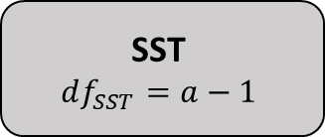
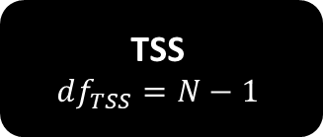


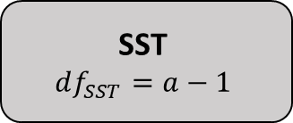
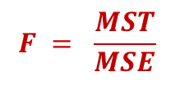
Recap of Last Lecture
Recap of Last Lecture:
Sums of Squares Decomposition
$$F = \frac{MST}{MSE}$$
TSS
$$df_{TSS}=N−1$$
By including the blocking factor in the design we capture the variability it causes in Y through the sums of squares for the blocking factor (SSB).
SST
$$df_{SST}=a−1$$
SSE₀
$$df_{SSE_{0}}=N−a$$
This reduces the SSE for the model compared to a non-blocked design and hence increases our power to detect factor effects.
SST
$$df_{SST}=a−1$$
SSB
$$df_{SSB}=b−1$$
SSE
$$df_{SSE}=N−a−b+1$$
18
Note that $N−1 −\left(a−1\right)−\left(b−1\right)=N −a −b+1$

Slide 19
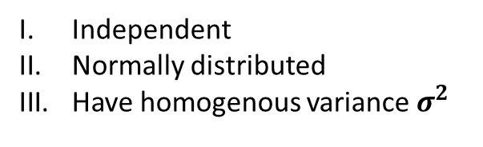
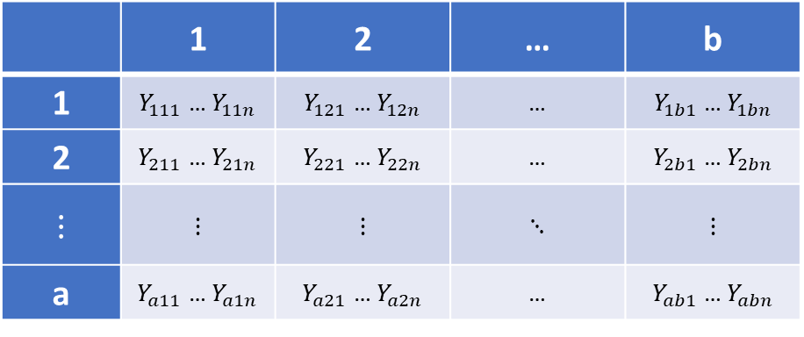
4.3 – Fixed Effects Model
4.3a – The Fixed Effects Model:
In an RBD with fixed effects, the response variable Y is modelled as a function of…
A treatment factor A with a levels
A blocking factor B with b levels
The factor A represents the effect of interest. The blocking factor represents the nuisance variable we wish to control for.
Each combination of factor and blocking levels is known as a cell such that there are ab cells in total.
We take a balanced sample of N observations (n in each cell) and express this in a two-way table
Blocking Factor (B) Levels
 | 1 | 2 | … | b
1 | $Y_{111}$ … $Y_{11n}$ | $Y_{121}$ … $Y_{12n}$ | … | $Y_{1b1}$ … $Y_{1bn}$
2 | $Y_{211}$ … $Y_{21n}$ | $Y_{221}$ … $Y_{22n}$ | … | $Y_{2b1}$ … $Y_{2bn}$
$$⋮$$ | $$⋮$$ | $$⋮$$ | $$⋱$$ | $$⋮$$
a | $Y_{a11}$ … $Y_{a1n}$ | $Y_{a21}$ … $Y_{a2n}$ | … | $Y_{ab1}$ … $Y_{abn}$
It is assumed that the data in each of the cells arise from distribution that are:
Independent
Normally distributed
Have homogenous variance $σ^{2}$
ANOVA Conditions
Factor (A) Levels
19

Slide 20
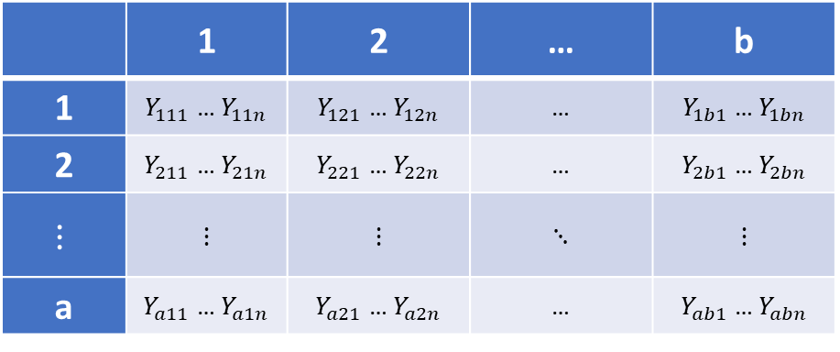
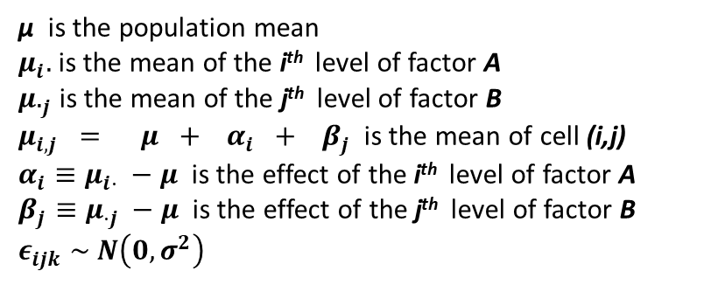
4.3 – Fixed Effects Model
4.3a – The Fixed Effects Model:
We take a balanced sample of N observations (n in each cell) and express this in a two-way table
Blocking Factor (B) Levels
 | 1 | 2 | … | b
1 | $Y_{111}$ … $Y_{11n}$ | $Y_{121}$ … $Y_{12n}$ | … | $Y_{1b1}$ … $Y_{1bn}$
2 | $Y_{211}$ … $Y_{21n}$ | $Y_{221}$ … $Y_{22n}$ | … | $Y_{2b1}$ … $Y_{2bn}$
$$⋮$$ | $$⋮$$ | $$⋮$$ | $$⋱$$ | $$⋮$$
a | $Y_{a11}$ … $Y_{a1n}$ | $Y_{a21}$ … $Y_{a2n}$ | … | $Y_{ab1}$ … $Y_{abn}$
The k^{th} observation in cell (i,j) is modelled as:
$$Y_{ijk} = μ + α_{i} + β_{j} + ε_{ijk}$$
Factor (A) Levels
μ is the population mean
$μ_{i}.$ is the mean of the i^{th} level of factor A $μ._{j}$ is the mean of the j^{th} level of factor B
$μ_{i,j} = μ + α_{i} + β_{j}$ is the mean of cell (i,j)
$α_{i}≡μ_{i⋅} −μ$ is the effect of the i^{th} level of factor A
$β_{j}≡μ_{⋅j} −μ$ is the effect of the j^{th} level of factor B
$$ε_{ijk} \sim N\left(0, σ^{2}\right)$$
20

Slide 21
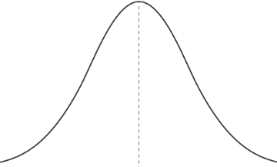








4.3 – Fixed Effects Model
4.3a – The Fixed Effects Model:
$$Y_{ijk} = μ + α_{i} + β_{j} + ε_{ijk}$$
Consider modelling $Y_{ijk}$
$$Y_{ijk}$$
$$α_{i}>0$$
$$β_{j}>0$$
$$μ$$
$$μ+α_{i}$$
$$μ+α_{i}+β_{j}$$
$$≡$$
$$μ_{ij}$$
21

Slide 22
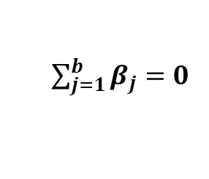
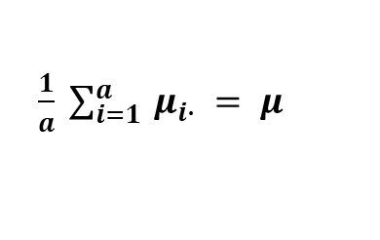

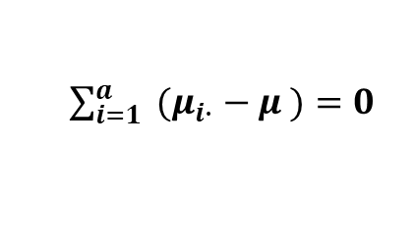
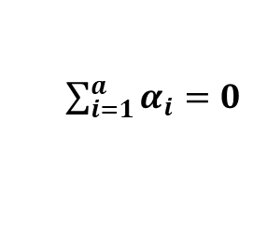
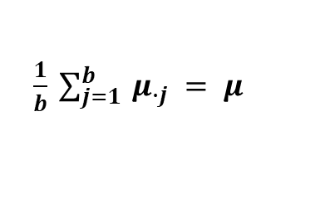
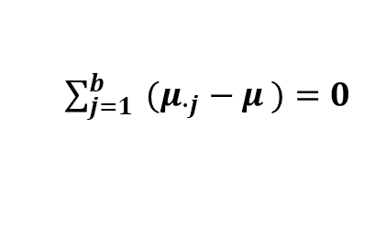
4.3 – Fixed Effects Model
4.3a – The Fixed Effects Model:
We take a balanced sample of N observations (n in each cell) and express this in a two-way table
Blocking Factor (B) Levels
 | 1 | 2 | … | b
1 | $Y_{111}$ … $Y_{11n}$ | $Y_{121}$ … $Y_{12n}$ | … | $Y_{1b1}$ … $Y_{1bn}$
2 | $Y_{211}$ … $Y_{21n}$ | $Y_{221}$ … $Y_{22n}$ | … | $Y_{2b1}$ … $Y_{2bn}$
$$⋮$$ | $$⋮$$ | $$⋮$$ | $$⋱$$ | $$⋮$$
a | $Y_{a11}$ … $Y_{a1n}$ | $Y_{a21}$ … $Y_{a2n}$ | … | $Y_{ab1}$ … $Y_{abn}$
The k^{th} observation in cell (i,j) is modelled as:
$$Y_{ijk} = μ + α_{i} + β_{j} + ε_{ijk}$$
Factor (A) Levels
μ is the population mean
$μ_{i}.$ is the mean of the i^{th} level of factor A $μ._{j}$ is the mean of the j^{th} level of factor B
$μ_{i,j} = μ + α_{i} + β_{j}$ is the mean of cell (i,j)
$α_{i}≡μ_{i⋅} −μ$ is the effect of the i^{th} level of factor A
$β_{j}≡μ_{⋅j} −μ$ is the effect of the j^{th} level of factor B
$$ε_{ijk} \sim N\left(0, σ^{2}\right)$$
We also have the constraints:
$\frac{1}{a} \sum_{i=1}^{a}{ μ_{i∙} = μ }$
The avg of the treatment level means is equal to the population mean
$\sum_{i=1}^{a}{α_{i}=0}$
⬄
$\sum_{i=1}^{a}{ {(μ}_{i∙} − μ )=0}$
⬄
⬄
$\frac{1}{b} \sum_{j=1}^{b}{ μ_{∙j} = μ }$
The avg of the blocking level means is equal to the population mean
$\sum_{j=1}^{b}{β_{j}=0}$
⬄
$\sum_{j=1}^{b}{ {(μ}_{∙j} − μ )=0}$
⬄
⬄
22

Slide 23

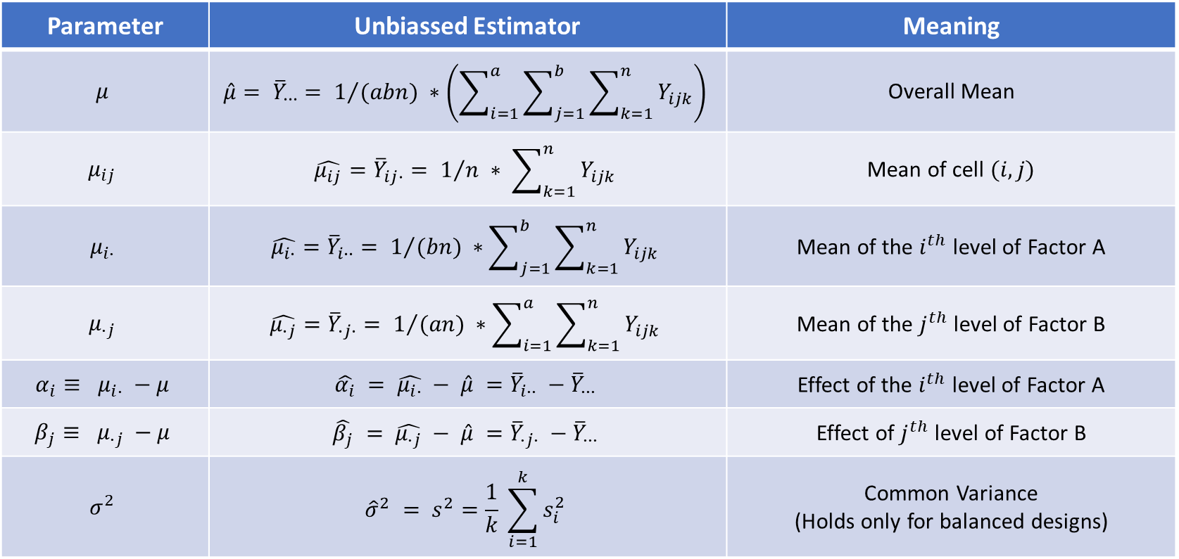
4.3 – Fixed Effects Model
4.3a – The Fixed Effects Model:
$$Y_{ijk} = μ + α_{i} + β_{j} + ε_{ijk}$$
Of course, we don’t know what the true values of the parameters in the model are.
As such, we must estimate these parameters from the data
Parameter | Unbiassed Estimator | Meaning
$$μ$$ | $${\hat{μ}= \overline{Y}}_{∙∙∙}= 1/{(abn)} ∗\left(\sum_{i=1}^{a}{\sum_{j=1}^{b}{\sum_{k=1}^{n}{Y_{ijk}}}}\right)$$ | Overall Mean
$$μ_{ij}$$ | $$\hat{μ_{ij}}={\overline{Y}}_{ij∙}= 1/n ∗ \sum_{k=1}^{n}{Y_{ijk}}$$ | Mean of cell $(i,j)$
$$μ_{i∙}$$ | $$\hat{μ_{i∙}}={\overline{Y}}_{i∙∙}= 1/{(bn}) ∗\sum_{j=1}^{b}{\sum_{k=1}^{n}{Y_{ijk}}}$$ | Mean of the $i^{th}$ level of Factor A
$$μ_{∙j}$$ | $$\hat{μ_{∙j}}={\overline{Y}}_{∙j∙}= 1/{(an}) ∗\sum_{i=1}^{a}{\sum_{k=1}^{n}{Y_{ijk}}}$$ | Mean of the $j^{th}$ level of Factor B
$$α_{i}≡ μ_{i∙} −μ$$ | $$\hat{α_{i}} = \hat{μ_{i∙}} − \hat{μ} ={\overline{Y}}_{i∙∙} −{\overline{Y}}_{∙∙∙}$$ | Effect of the $i^{th}$ level of Factor A
$$β_{j}≡ μ_{∙j} −μ$$ | $$\hat{β_{j}} = \hat{μ_{∙j}} − \hat{μ} ={\overline{Y}}_{∙j∙} −{\overline{Y}}_{∙∙∙}$$ | Effect of $j^{th}$ level of Factor B
$$σ^{2}$$ | $${{\hat{σ}}^{2} = s}^{2}=\frac{1}{k} \sum_{i=1}^{k}{s_{i}^{2}}$$ | Common Variance (Holds only for balanced designs)
23

Slide 24

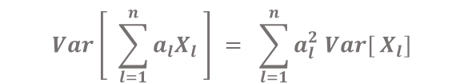


4.3 – Fixed Effects Model
4.3a – The Fixed Effects Model:
$$Y_{ijk} = μ + α_{i} + β_{j} + ε_{ijk}$$
Expectation of the k^{th} observation in cell (i,j)
$$E\left[ Y_{ijk} \right] = E\left[μ + α_{i} + β_{j} + ε_{ijk}\right]$$
$$= E\left[ μ \right] + E\left[ α_{i} \right] + E\left[ β_{j}\right] + E\left[ ε_{ijk} \right]$$
$$= μ + α_{i} + β_{j}$$
$$= μ_{ij}$$
Variance of the k^{th} observation in cell (i,j)
$$Var\left[ \sum_{l=1}^{n}{a_{l}X_{l}} \right] = \sum_{l=1}^{n}{a_{l}^{2} Var[ X_{l}]}$$
$$Var\left[ Y_{ijk} \right] =Var\left[μ + α_{i} + β_{j} + ε_{ijk}\right]$$
$$= {\left(1\right)}^{2} Var\left[ μ \right] + {\left(1\right)}^{2} Var\left[ α_{i} \right] + {\left(1\right)}^{2} Var\left[ β_{j}\right] + {\left(1\right)}^{2} Var\left[ ε_{ijk} \right]$$
$$= 0 + 0 + 0 + σ^{2}$$
$$={ σ}^{2}$$
24

Slide 25
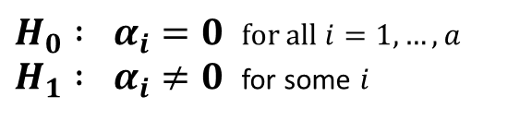
4.3 – Fixed Effects Model
4.3a – The Fixed Effects Model:
We wish to test whether or not there is an effect of the treatment factor on the response variable.
In other words, we want to test between the hypotheses:
$H_{0} : α_{i}=0$ for all $i=1, …, a$ $H_{1} : α_{i}≠0$ for some $i$
$$Y_{ijk} = μ + α_{i} + β_{j} + ε_{ijk}$$
We are NOT interested in testing whether the blocking factor (the nuisance variable) has an effect on the response variable. We have assumed a priori that it does and we are trying to control for this.
Example:
A study is undertaken to determine whether there is any difference in the ability of two prescription drugs (Atorvastatin and Pravastatin) to reduce the level of cholesterol in the blood stream of patients. Since cholesterol levels are known to increase with age, the age of study participants is a nuisance variable.
Response Variable Cholesterol level
Treatment Factor Prescription drug
Treatment Levels Atorvastatin, Pravastatin
Blocking Factor Age
Blocking Levels 18-30, 31-40, 41-50, 51-65, 65+
We are interested in testing whether Atorvastatin or Pravastatin is better at reducing cholesterol.
We are not interested in testing whether age has an effect on cholesterol. We want to control for this.
25

Slide 26
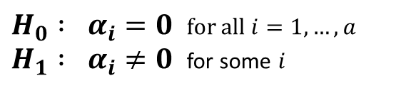
4.3 – Fixed Effects Model
4.3a – The Fixed Effects Model:
Strictly speaking the experimental set up of a randomised block design prevents us from being able to test for blocking effects anyway…
While the RBD model might look like the model for a two-way ANOVA (without interactions), treatments in a RBD are allocated randomly within blocks, not completely at random over the experimental units as in a two-way ANOVA design.
This means that whilst we may test for treatment effects allowing for blocking effects… the test of blocks allowing for treatments would not be valid as conditions of randomness for this test are not properly met.
We want to test whether or not there is an effect of the treatment factor on the response variable.
$H_{0} : α_{i}=0$ for all $i=1, …, a$ $H_{1} : α_{i}≠0$ for some $i$
How can we do this?
26

Slide 27
4.3 – Fixed Effects Model
4.3b – Breakdown of Basic Sums of Squares:
✓
✓
Lemma:
$$Y_{ijk} − {\overline{Y}}_{∙∙∙} = \left({ \overline{Y}}_{i∙∙} − {\overline{Y}}_{∙∙∙} \right) + \left({ \overline{Y}}_{∙j∙} − {\overline{Y}}_{∙∙∙} \right) + \left(Y_{ijk} −{ \overline{Y}}_{i∙∙}−{ \overline{Y}}_{∙j∙}+ {\overline{Y}}_{∙∙∙} \right)$$
Proof: Simply write out the right hand side and collect like terms. □
27

Slide 28
4.3 – Fixed Effects Model
4.3b – Breakdown of Basic Sums of Squares:
Lemma:
$$Y_{ijk} − {\overline{Y}}_{∙∙∙} = \left({ \overline{Y}}_{i∙∙} − {\overline{Y}}_{∙∙∙} \right) + \left({ \overline{Y}}_{∙j∙} − {\overline{Y}}_{∙∙∙} \right) + \left(Y_{ijk} −{ \overline{Y}}_{i∙∙}−{ \overline{Y}}_{∙j∙}+ {\overline{Y}}_{∙∙∙} \right)$$
Proof: Simply write out the right hand side and collect like terms. □
The model for a RBD is given by:
$$Y_{ijk} = μ + α_{i} + β_{j} + ε_{ijk}$$
=>
$$Y_{ijk} − μ = α_{i} + β_{j} + ε_{ijk}$$
est
est
est
est
$$Y_{ijk} − {\overline{Y}}_{∙∙∙} = \left({ \overline{Y}}_{i∙∙} − {\overline{Y}}_{∙∙∙} \right) + \left({ \overline{Y}}_{∙j∙} − {\overline{Y}}_{∙∙∙} \right) + \left(Y_{ijk} −{ \overline{Y}}_{i∙∙}−{ \overline{Y}}_{∙j∙}+ {\overline{Y}}_{∙∙∙} \right)$$
In particular, $\left(Y_{ijk} −{ \overline{Y}}_{i∙∙}−{ \overline{Y}}_{∙j∙}+ {\overline{Y}}_{∙∙∙} \right)$ is an estimate of $ε_{ijk}$
28

Slide 29
4.3 – Fixed Effects Model
4.3b – Breakdown of Basic Sums of Squares:
$$Y_{ijk} = μ + α_{i} + β_{j} + ε_{ijk}$$
Of course, we don’t know what the true values of the parameters in the model are.
As such, we must estimate these parameters from the data
Parameter | Unbiassed Estimator | Meaning
$$μ$$ | $${\hat{μ}= \overline{Y}}_{∙∙∙}= 1/{(abn)} ∗\left(\sum_{i=1}^{a}{\sum_{j=1}^{b}{\sum_{k=1}^{n}{Y_{ijk}}}}\right)$$ | Overall Mean
$$μ_{ij}$$ | $$\hat{μ_{ij}}={\overline{Y}}_{ij∙}= 1/n ∗ \sum_{k=1}^{n}{Y_{ijk}}$$ | Mean of cell $(i,j)$
$$μ_{i∙}$$ | $$\hat{μ_{i∙}}={\overline{Y}}_{i∙∙}= 1/{(bn}) ∗\sum_{j=1}^{b}{\sum_{k=1}^{n}{Y_{ijk}}}$$ | Mean of the $i^{th}$ level of Factor A
$$μ_{∙j}$$ | $$\hat{μ_{∙j}}={\overline{Y}}_{∙j∙}= 1/{(an}) ∗\sum_{i=1}^{a}{\sum_{k=1}^{n}{Y_{ijk}}}$$ | Mean of the $j^{th}$ level of Factor B
$$α_{i}≡ μ_{i∙} −μ$$ | $$\hat{α_{i}} = \hat{μ_{i∙}} − \hat{μ} ={\overline{Y}}_{i∙∙} −{\overline{Y}}_{∙∙∙}$$ | Effect of the $i^{th}$ level of Factor A
$$β_{j}≡ μ_{∙j} −μ$$ | $$\hat{β_{j}} = \hat{μ_{∙j}} − \hat{μ} ={\overline{Y}}_{∙j∙} −{\overline{Y}}_{∙∙∙}$$ | Effect of $j^{th}$ level of Factor B
$$σ^{2}$$ | $${{\hat{σ}}^{2} = s}^{2}=\frac{1}{k} \sum_{i=1}^{k}{s_{i}^{2}}$$ | Common Variance (Holds only for balanced designs)
29

Slide 30
4.3 – Fixed Effects Model
4.3b – Breakdown of Basic Sums of Squares:
Lemma:
$$Y_{ijk} − {\overline{Y}}_{∙∙∙} = \left({ \overline{Y}}_{i∙∙} − {\overline{Y}}_{∙∙∙} \right) + \left({ \overline{Y}}_{∙j∙} − {\overline{Y}}_{∙∙∙} \right) + \left(Y_{ijk} −{ \overline{Y}}_{i∙∙}−{ \overline{Y}}_{∙j∙}+ {\overline{Y}}_{∙∙∙} \right)$$
Proof: Simply write out the right hand side and collect like terms. □
Note that by definition of the model for a RBD we have that
$$Y_{ijk} = μ + α_{i} + β_{j} + ε_{ijk}$$
=>
$$Y_{ijk} − μ = α_{i} + β_{j} + ε_{ijk}$$
est
est
est
est
$$Y_{ijk} − {\overline{Y}}_{∙∙∙} = \left({ \overline{Y}}_{i∙∙} − {\overline{Y}}_{∙∙∙} \right) + \left({ \overline{Y}}_{∙j∙} − {\overline{Y}}_{∙∙∙} \right) + \left(Y_{ijk} −{ \overline{Y}}_{i∙∙}−{ \overline{Y}}_{∙j∙}+ {\overline{Y}}_{∙∙∙} \right)$$
In particular, $\left(Y_{ijk} −{ \overline{Y}}_{i∙∙}−{ \overline{Y}}_{∙j∙}+ {\overline{Y}}_{∙∙∙} \right)$ is an estimate of $ε_{ijk}$
30

Slide 31
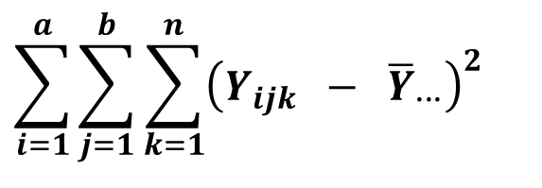
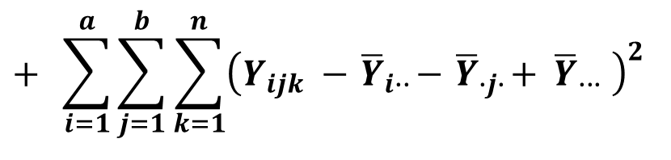
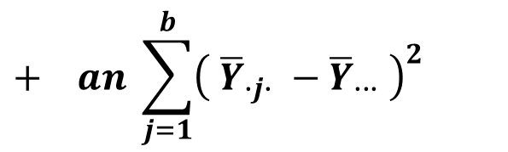
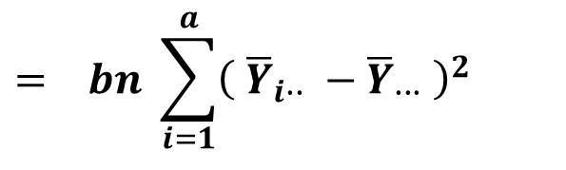
4.3 – Fixed Effects Model
4.3b – Breakdown of Basic Sums of Squares:
$$Y_{ijk} − {\overline{Y}}_{∙∙∙} = \left({ \overline{Y}}_{i∙∙} − {\overline{Y}}_{∙∙∙} \right) + \left({ \overline{Y}}_{∙j∙} − {\overline{Y}}_{∙∙∙} \right) + \left(Y_{ijk} −{ \overline{Y}}_{i∙∙}−{ \overline{Y}}_{∙j∙}+ {\overline{Y}}_{∙∙∙} \right)$$
If we square both sides of the above equation and sum over all observations we obtain*:
$$\sum_{i=1}^{a}{\sum_{j=1}^{b}{\sum_{k=1}^{n}{{\left(Y_{ijk} − {\overline{Y}}_{∙∙∙}\right)}^{2}}}}$$
Total Sum of Squares (TSS)
$$= bn \sum_{i=1}^{a}{{\left({ \overline{Y}}_{i∙∙} − {\overline{Y}}_{∙∙∙} \right)}^{2}}$$
Sum of Squares for treatments (SST)
TSS = SST + SSB + SSE
$$+ an \sum_{j=1}^{b}{{\left({ \overline{Y}}_{∙j∙} − {\overline{Y}}_{∙∙∙} \right)}^{2}}$$
Sum of Squares for blocks (SSB)
$$+ \sum_{i=1}^{a}{\sum_{j=1}^{b}{\sum_{k=1}^{n}{{\left(Y_{ijk} −{ \overline{Y}}_{i∙∙}−{ \overline{Y}}_{∙j∙}+ {\overline{Y}}_{∙∙∙} \right)}^{2}}}}$$
Sum of Squares for Errors (SSE)
This is the residual variation after accounting for treatments and blocks
31
*The proof of this statement is not required for Stat 293 but is available as supplementary material on the intranet.

Slide 32
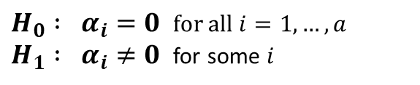
4.3 – Fixed Effects Model
4.3c – Hypothesis Testing for the Fixed Effects Model:
We want to test whether or not there is an effect of treatment on the response variable.
$H_{0} : α_{i}=0$ for all $i=1, …, a$ $H_{1} : α_{i}≠0$ for some $i$
The ANOVA table below shows all the relevant sums of squares, degrees of freedom and mean squares for a RBD:
Source of Variation | df | SS | Mean Square | F-Statistic
Total | N-1 | TSS
Treatment | a-1 | SST | MST = SST / (a-1) | MST / MSE
Blocks | b-1 | SSB | MSB = SSB / (b-1) | MSB / MSE
Residual | N-a-b+1 | SSE | MSE = SSE / (N-a-b+1)
The F-statistic for our hypothesis test is:
$$F = \frac{MST}{MSE} = \frac{{SST}/{(a−1)}}{{SSE}/{(N−a−b+1)}} = \frac{{bn \sum_{i=1}^{a}{{\left({ \overline{Y}}_{i∙∙} − {\overline{Y}}_{∙∙∙} \right)}^{2}}}/{(a−1)}}{{\sum_{i=1}^{a}{\sum_{j=1}^{b}{\sum_{k=1}^{n}{{\left(Y_{ijk} −{ \overline{Y}}_{i∙∙}−{ \overline{Y}}_{∙j∙}+ {\overline{Y}}_{∙∙∙} \right)}^{2}}}}}/{(N−a−b+1)}}$$
If the ANOVA conditions of independence, normality and constant variance hold in each cell then $F \sim F_{a−1 , N−a−b+1}$
We calculate the value of F_{obs} and see where this lies in the distribution of $F_{a−1 , N−a−b+1}$.
The smaller the p-value $P( F≥F_{obs})$ the more evidence we have against the null hypothesis.
32

Slide 33
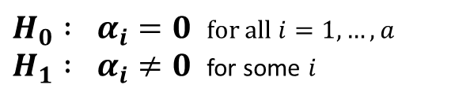
4.3 – Fixed Effects Model
4.3d – Clotting Time of Blood Plasma Example:
The overall effects of four different treatments on the clotting time of blood plasma are to be investigated. To control for underlying differences in clotting rates among individuals, a fixed effects randomised block design was used with Subjects as blocks. Four samples of plasma were collected from each of eight subjects (the 'blocks’). The four treatments were then were assigned in random order to the four samples of each subject, ie each subject received all four treatments.
The adjacent table shows the data (clotting time in minutes) pertaining to this experiment in ‘wide’ format. The csv data set entitled ‘plasma’ shows the same data in ‘thin’ format.
Subject | T1 | T2 | T3 | T4 | Means
1 | 8.4 | 9.4 | 9.8 | 12.2 | 9.95
2 | 12.8 | 15.2 | 12.9 | 14.4 | 13.83
3 | 9.6 | 9.1 | 11.2 | 9.8 | 9.93
4 | 9.8 | 8.8 | 9.9 | 12 | 10.13
5 | 8.4 | 8.2 | 8.5 | 8.5 | 8.4
6 | 8.6 | 9.9 | 9.8 | 10.9 | 9.8
7 | 8.9 | 9 | 9.2 | 10.4 | 9.38
8 | 7.9 | 8.1 | 8.2 | 10 | 8.55
Means | 9.3 | 9.7 | 9.9 | 11 | 9.99
Is there an effect of treatment on clotting time?
Response Variable Clotting Time
Treatment Factor (A) Treatment
Treatment Levels T1, T2, T3, T4
Blocking Factor (B) Subject
Blocking Levels 1, 2, 3, 4, 5, 6, 7, 8
$H_{0} : α_{i}=0$ for all $i=1, …, a$ $H_{1} : α_{i}≠0$ for some $i$
33
Associated code = 4.3 - Clotting Time of Blood Plasma (Fixed Effects RBD Example)

Slide 34
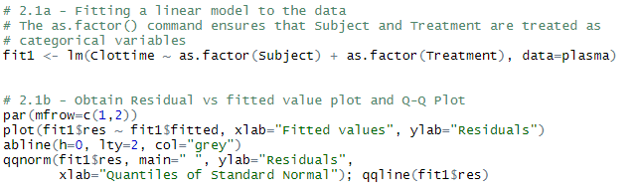
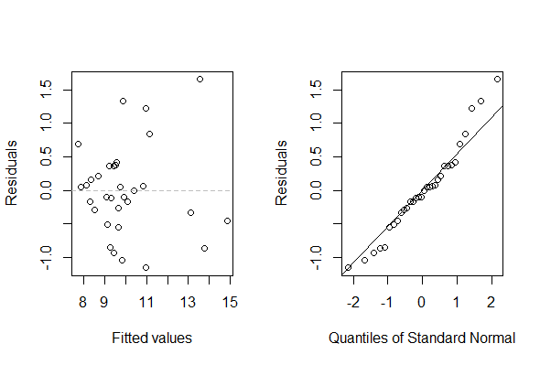
4.3 – Fixed Effects Model
4.3d – Clotting Time of Blood Plasma Example:
Plot of residuals vs fitted values suggests non-constant variance (but doesn’t really tell you much).
QQ Plot suggests non-normality at the top end of the distribution.
ANOVA conditions unlikely to be satisfied
ANOVA results likely to be invalid
34
Associated code = 4.3 - Clotting Time of Blood Plasma (Fixed Effects RBD Example)

Slide 35

4.3 – Fixed Effects Model
4.3d – Clotting Time of Blood Plasma Example:
Source of Variation | df | SS | Mean Square | F-Statistic
Total | N-1 | TSS
Treatment | a-1 | SST | MST = SST / (a-1) | MST / MSE
Blocks | b-1 | SSB | MSB = SSB / (b-1) | MSB / MSE
Residual | N-a-b+1 | SSE | MSE = SSE / (N-a-b+1)
Analysis of Variance Table
Response: Clottime
Df Sum Sq Mean Sq F value Pr(>F)
as.factor(Subject) 7 78.989 11.2841 17.204 2.197e-07 ***
as.factor(Treatment) 3 13.016 4.3388 6.615 0.00255 **
Residuals 21 13.774 0.6559
Very strong evidence against the null hypothesis
=> Very strong evidence that treatment effects differ after controlling for subject-to-subject variation in clotting time
35
Associated code = 4.3 - Clotting Time of Blood Plasma (Fixed Effects RBD Example)

Slide 36

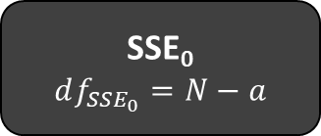

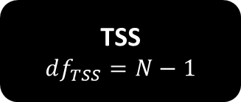
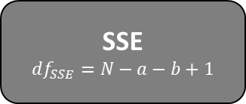
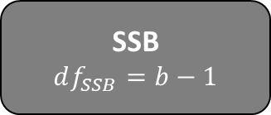

4.3 – Fixed Effects Model
4.3d – Clotting Time of Blood Plasma Example:
Sums of Squares Decomposition
$$F = \frac{MST}{MSE}$$
TSS
$$df_{TSS}=N−1$$
What would have happened if we ignored subject to subject variation and treated this as a one-way ANOVA?
One-Way ANOVA
SST
$$df_{SST}=a−1$$
SSE₀
$$df_{SSE_{0}}=N−a$$
Randomised Block Design
SST
$$df_{SST}=a−1$$
SSB
$$df_{SSB}=b−1$$
SSE
$$df_{SSE}=N−a−b+1$$
36

Slide 37


4.3 – Fixed Effects Model
4.3d – Clotting Time of Blood Plasma Example:
RANDOMISED BLOCK DESIGN
ONE WAY ANOVA
Analysis of Variance Table
Response: Clottime
Df Sum Sq Mean Sq F value Pr(>F)
as.factor(Subject) 7 78.989 11.2841 17.204 2.197e-07 as.factor(Treatment) 3 13.016 4.3388 6.615 0.00255
Residuals 21 13.774 0.6559
Analysis of Variance Table
Response: Clottime
Df Sum Sq Mean Sq F value Pr(>F)
as.factor(Treatment) 3 13.016 4.3388 1.3096 0.2909
Residuals 28 92.762 3.3129
The SST and MST is the same under both approaches
However, the SSE is much smaller under the RBD compared to one-way ANOVA. This is because in one-way ANOVA the variance caused by the blocking factor (Subject) has not been accounted for. This variation has been incorporated in the SSE inflating it considerably
Consequently, $F_{obs}$ is much bigger under the RBD and the p-value is much smaller.
37
Associated code = 4.3 - Clotting Time of Blood Plasma (Fixed Effects RBD Example)

Slide 38
4.3 – Fixed Effects Model
4.3d – Clotting Time of Blood Plasma Example:
Sums of Squares Decomposition
$$F = \frac{MST}{MSE}$$
TSS
$$df_{TSS}=N−1$$
The process of blocking within a RBD accounts for a substantial source of variance giving greater power to test for the effect of a treatment
One-Way ANOVA
SST
$$df_{SST}=a−1$$
SSE₀
$$df_{SSE_{0}}=N−a$$
Randomised Block Design
SST
$$df_{SST}=a−1$$
SSB
$$df_{SSB}=b−1$$
SSE
$$df_{SSE}=N−a−b+1$$
38

Slide 39
4.4 – Mixed Effects Model

Slide 40
Recap of Last Lecture
Recap of Last Lecture:
Sums of Squares Decomposition
$$F = \frac{MST}{MSE}$$
TSS
$$df_{TSS}=N−1$$
The process of blocking within a RBD accounts for a substantial source of variance giving greater power to test for the effect of a treatment
One-Way ANOVA
SST
$$df_{SST}=a−1$$
SSE₀
$$df_{SSE_{0}}=N−a$$
Randomised Block Design
SST
$$df_{SST}=a−1$$
SSB
$$df_{SSB}=b−1$$
SSE
$$df_{SSE}=N−a−b+1$$
40

Slide 41
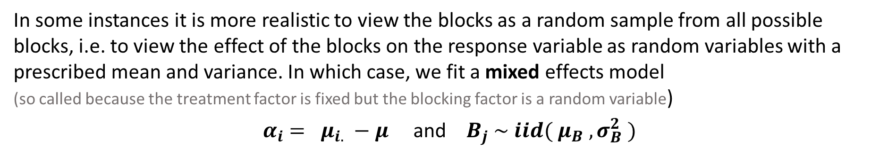
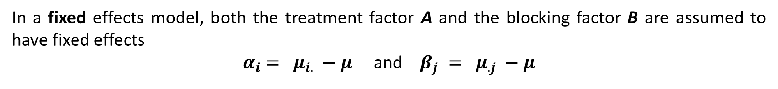
4.4 – Mixed Effects Model
4.4a – The Mixed Effects Model:
In a fixed effects model, both the treatment factor A and the blocking factor B are assumed to have fixed effects
${ α}_{i} = μ_{i.} −μ$ and $β_{j} = μ_{.j} −μ$
In some instances it is more realistic to view the blocks as a random sample from all possible blocks, i.e. to view the effect of the blocks on the response variable as random variables with a prescribed mean and variance. In which case, we fit a mixed effects model (so called because the treatment factor is fixed but the blocking factor is a random variable)
${ α}_{i} = μ_{i.} −μ$ and $B_{j} \sim iid( μ_{B} , σ_{B}^{2} )$
As a general rule for Stat 293…
if we say that the blocking factor is “randomly selected”
…then we are talking about a mixed effects model.
41

Slide 42
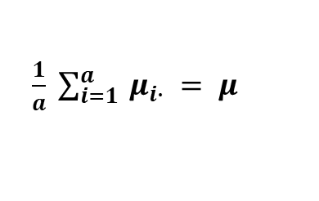
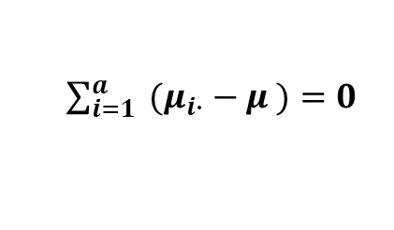
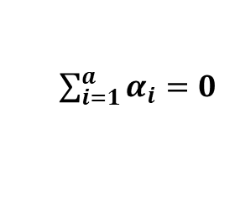
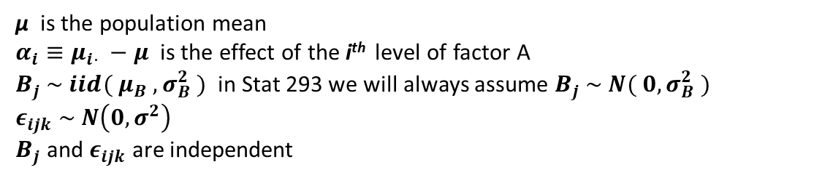
4.4 – Mixed Effects Model
4.4a – The Mixed Effects Model:
In an RBD with mixed effects, the response variable Y is modelled as a function of…
a treatment factor A with a levels
a random variable B included in the model to account for a recognised source of variation in Y.
The factor A represents the effect of interest. The random variable B represents the nuisance variable we wish to control for.
For a mixed effects model the $k^{th}$ observation belonging to the $i^{th}$ level of factor A and the j^{th} block is modelled as:
$$Y_{ijk} = μ + α_{i} + B_{j} + ε_{ijk}$$
μ is the population mean
$α_{i}≡μ_{i⋅} −μ$ is the effect of the i^{th} level of factor A
$B_{j} \sim iid( μ_{B} , σ_{B}^{2} )$ in Stat 293 we will always assume $B_{j} \sim N( 0, σ_{B}^{2} )$
$$ε_{ijk} \sim N\left(0, σ^{2}\right)$$
$B_{j}$ and $ε_{ijk}$are independent
We also have the usual constraint:
$\frac{1}{a} \sum_{i=1}^{a}{ μ_{i∙} = μ }$
The avg of the factor level means is equal to the population mean
$\sum_{i=1}^{a}{α_{i}=0}$
⬄
$\sum_{i=1}^{a}{ {(μ}_{i∙} − μ )=0}$
⬄
⬄
42

Slide 43
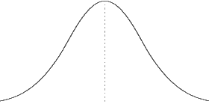


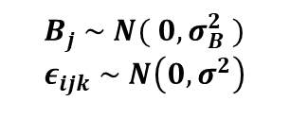
4.4 – Mixed Effects Model
4.4a – The Mixed Effects Model:
$B_{j} \sim N( 0, σ_{B}^{2} )$
$$ε_{ijk} \sim N\left(0, σ^{2}\right)$$
$$Y_{ijk} = μ + α_{i} + B_{j} + ε_{ijk}$$
Consider modelling $Y_{ijk}$
$$Y_{ijk}$$
$$α_{i}>0$$
$$μ$$
$$μ+α_{i}$$
$$μ+α_{i}+B_{j}$$
43

Slide 44
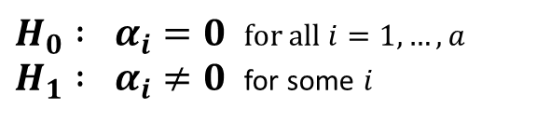

4.4 – Mixed Effects Model
4.4a – The Mixed Effects Model:
In an RBD with mixed effects, the response variable Y is modelled as a function of…
a treatment factor A with a levels
a random variable B included in the model to account for a recognised source of variation in Y.
The factor A represents the effect of interest. The random variable B represents the nuisance variable we wish to control for.
For a mixed effects model the $k^{th}$ observation belonging to the $i^{th}$ level of factor A and the j^{th} block is modelled as:
$$Y_{ijk} = μ + α_{i} + B_{j} + ε_{ijk}$$
$B_{j} \sim N( 0, σ_{B}^{2} )$
$$ε_{ijk} \sim N\left(0, σ^{2}\right)$$
Note that we have that:
$$E\left[ Y_{ijk} \right] = E\left[ μ \right] + E\left[ α_{i} \right] + E\left[ B_{j}\right] + E\left[ ε_{ijk} \right] = μ + α_{i} + 0 + 0 = μ + μ_{i∙} − μ = μ_{i∙}$$
$$Var\left[ Y_{ijk} \right] = Var\left[ μ \right] + Var\left[ α_{i} \right] + Var\left[ B_{j}\right] + Var\left[ ε_{ijk} \right] = 0 + 0 + σ_{B}^{2} + σ^{2} = σ_{B}^{2} + σ^{2}$$
We want to test whether or not there is an effect of the treatment factor on the response variable.
$H_{0} : α_{i}=0$ for all $i=1, …, a$ $H_{1} : α_{i}≠0$ for some $i$
44

Slide 45

4.4 – Mixed Effects Model
4.4a – The Mixed Effects Model:
In an RBD with mixed effects, the response variable Y is modelled as a function of…
a treatment factor A with a levels
a random variable B included in the model to account for a recognised source of variation in Y.
The factor A represents the effect of interest. The random variable B represents the nuisance variable we wish to control for.
For a mixed effects model the $k^{th}$ observation belonging to the $i^{th}$ level of factor A and the j^{th} block is modelled as:
$$Y_{ijk} = μ + α_{i} + B_{j} + ε_{ijk}$$
$B_{j} \sim N( 0, σ_{B}^{2} )$
$$ε_{ijk} \sim N\left(0, σ^{2}\right)$$
Note that we have that:
$$E\left[ Y_{ijk} \right] = E\left[ μ \right] + E\left[ α_{i} \right] + E\left[ B_{j}\right] + E\left[ ε_{ijk} \right] = μ + α_{i} + 0 + 0 = μ + μ_{i∙} − μ = μ_{i∙}$$
$$Var\left[ Y_{ijk} \right] = Var\left[ μ \right] + Var\left[ α_{i} \right] + Var\left[ B_{j}\right] + Var\left[ ε_{ijk} \right] = 0 + 0 + σ_{B}^{2} + σ^{2} = σ_{B}^{2} + σ^{2}$$
As well as testing for the effect of Factor A, we are interested in the proportion of variance (after allowing for treatment) that is due to
Block effects ${σ_{B}^{2} }/{( σ_{B}^{2} + σ^{2} )}$
Residual unexplained variation ${σ^{2} }/{( σ_{B}^{2} + σ^{2} )}$
45
Naturally, ${ σ}_{B}^{2}$ and $σ^{2}$ must be estimated from the data.

Slide 46


4.4 – Mixed Effects Model
4.4b – Clotting Time of Blood Plasma Example:
The overall effects of four different treatments on the clotting time of blood plasma are to be investigated. To control for underlying differences in clotting rates among individuals, a mixed effects randomised block design was used with Subjects as blocks. Four samples of plasma were collected from eight randomly selected subjects (the 'blocks’). The four treatments were then were assigned in random order to the four samples of each subject.
The adjacent table shows the data (clotting time in minutes) pertaining to this experiment in ‘wide’ format. The csv data set entitled ‘plasma’ shows the same data in ‘thin’ format.
Subject | T1 | T2 | T3 | T4 | Means
1 | 8.4 | 9.4 | 9.8 | 12.2 | 9.95
2 | 12.8 | 15.2 | 12.9 | 14.4 | 13.83
3 | 9.6 | 9.1 | 11.2 | 9.8 | 9.93
4 | 9.8 | 8.8 | 9.9 | 12 | 10.13
5 | 8.4 | 8.2 | 8.5 | 8.5 | 8.4
6 | 8.6 | 9.9 | 9.8 | 10.9 | 9.8
7 | 8.9 | 9 | 9.2 | 10.4 | 9.38
8 | 7.9 | 8.1 | 8.2 | 10 | 8.55
Means | 9.3 | 9.7 | 9.9 | 11 | 9.99
Is there an effect of treatment on clotting time?
What % of the variance is due to block effects and what % is due to unexplained residual variation?
Response Variable Clotting Time
Treatment Factor (A) Treatment
Treatment Levels T1, T2, T3, T4
Blocking Factor (B) Subject $B \sim N( 0 , σ_{B}^{2} )$
$H_{0} : α_{i}=0$ for all $i=1, …, a$ $H_{1} : α_{i}≠0$ for some $i$
46
Associated code = 4.4 - Clotting Time of Blood Plasma (Mixed Effects RBD Example)

Slide 47


4.4 – Mixed Effects Model
4.4b – Clotting Time of Blood Plasma Example:
Plot of residuals vs fitted values suggests non-constant variance
QQ Plot suggests non-normality at the top end of the distribution.
ANOVA conditions unlikely to be satisfied
ANOVA results likely to be invalid
47
Associated code = 4.4 - Clotting Time of Blood Plasma (Mixed Effects RBD Example)

Slide 48

4.4 – Mixed Effects Model
4.4b – Clotting Time of Blood Plasma Example:
Analysis of Variance Table
Response: Clottime
numDF denDF F-value p-value
(Intercept) 1 21 283.23032 <.0001
Treatment 3 21 6.61503 0.0025
Very strong evidence against the null hypothesis
=> Very strong evidence that treatment effects differ after controlling for subject-to-subject variation in clotting time
48
Associated code = 4.4 - Clotting Time of Blood Plasma (Mixed Effects RBD Example)

Slide 49
4.4 – Mixed Effects Model
4.4b – Clotting Time of Blood Plasma Example:
See slide 35 or the left hand side of slide 37
MIXED EFFECTS MODEL
FIXED EFFECTS MODEL
Analysis of Variance Table
Response: Clottime
numDF denDF F-value p-value
(Intercept) 1 21 283.23032 <.0001
Treatment 3 21 6.61503 0.0025
Analysis of Variance Table
Response: Clottime
Df Sum Sq Mean Sq F value Pr(>F)
as.factor(Subject) 7 78.989 11.2841 17.204 2.197e-07 as.factor(Treatment) 3 13.016 4.3388 6.615 0.00255
Residuals 21 13.774 0.6559
In terms of treatment factor effects for the randomised block designs described in Stat 293:
The F-statistic, degrees of freedom and p-value will always be the same for fixed or mixed effects model.
Only the calculation of the standard error of a treatment means will differ between model types. This is not of interest in Stat 293.
However, in a mixed effects model we still want to determine the proportion of variance (after allowing for treatment) that is due to block effects and the proportion due to unexplained residual variation.
49
Associated code = 4.4 - Clotting Time of Blood Plasma (Mixed Effects RBD Example)

Slide 50



4.4 – Mixed Effects Model
4.4b – Clotting Time of Blood Plasma Example:
${\hat{σ}}_{B}^{2}=1.630047^{2}$
$${\hat{σ}}^{2}=0.8098721^{2}$$
% of variance due to block effects:
$\frac{{\hat{σ}}_{B}^{2}}{{\hat{σ}}_{B}^{2} + {\hat{σ}}^{2}} = \frac{1.630047^{2}}{1.630047^{2} + 0.8098721^{2}}$ = 80.2%
% of variance due to residual unexplained variation
$\frac{{\hat{σ}}^{2}}{{\hat{σ}}_{B}^{2} + {\hat{σ}}^{2}} =\frac{0.8098721^{2}}{1.630047^{2} + 0.8098721^{2}}$ = 19.8%
=> Very low proportion of the variance in the data is due to unexplained residual variation
50
Associated code = 4.4 - Clotting Time of Blood Plasma (Mixed Effects RBD Example)

Slide 51
4.4 – Mixed Effects Model
4.4c – Fixed vs Mixed Effects Model:
As a general rule for Stat 293…
if we say that the blocking factor is “randomly selected”
…then we are talking about a mixed effects model. Otherwise we are talking about a fixed effects model.
For the randomised block designs described in Stat 293, the two approaches will give the exact same results in terms of testing for treatment effects. (The two approaches will differ only in the calculation of the standard error of a treatment mean - which is not of interest to us).
In the wider (non Stat 293) world the choice of whether to use a fixed or mixed effects model should be decided on a case by case basis. See here for a discussion of the issues involved.
51

Slide 52
4.5 – Permutation Testing in Randomised Block Designs

Slide 53
4.5 – Permutation Tests in RBDs
4.5a – Permutation Tests in RBDs:
In a RBD it is assumed that the data in each of the cells arise from distribution that are:
Independent
Normally distributed
Have homogenous variance
ANOVA Conditions
If the ANOVA conditions are violated, then whilst we can still calculate the observed F-statistic, this will no longer follow an F distribution such that any p-values produced within such a process will be meaningless.
We will need to test between the null and alternative hypothesis for treatment effects using a permutation test.
However, in a RBD the permutations (i.e. the switching of observations between treatments) must be carried out within blocks as opposed to over all experimental units.
Block 1
Block 2
Block 3
Block 4
A
C
B
C
B
A
A
B
C
B
A
C
Original Blocked Sample
B
A
C
B
C
A
A
C
B
A
C
B
C
B
A
A
C
B
B
A
C
B
C
A
Switch observations between treatments within each block.
A
B
C
C
C
C
A
B
B
B
A
C
A
C
B
B
A
A
A
C
B
C
A
B
53
C
B
A
A
B
B
C
A
C
C
B
A

Slide 54









4.5 – Permutation Tests in RBDs
4.5a – Permutation Tests in RBDs:
Block 1
Block 2
Block 3
Block 4
Original Blocked Sample
A
C
B
C
B
A
A
B
C
B
A
C
B
A
C
B
C
A
A
C
B
A
C
B
Calculate F-Statistic ($F_{Obs}$)
C
B
A
A
C
B
B
A
C
B
C
A
1st re-ordered sample
A
B
C
C
C
C
A
B
B
B
A
C
A
C
B
B
A
A
A
C
B
C
A
B
Calculate F-Statistic ($F_{1}$)
C
B
A
A
B
B
C
A
C
C
B
A
$$⋮$$
$$⋮$$
$$⋮$$
$$⋮$$
Lth re-ordered sample
B
A
A
A
C
C
B
B
B
B
B
C
A
B
C
B
A
B
A
A
C
A
C
B
Calculate F-Statistic ($F_{L}$)
B
C
C
C
B
A
A
C
C
C
A
A
Where does $F_{Obs}$ lie in the distribution of test statistic produced? $$P\left(F≥F_{Obs}\right)≈ \frac{\# F_{i}≥F_{Obs}}{L}$$
54

Slide 55
4.5 – Permutation Tests in RBDs
4.5a – Permutation Tests in RBDs:
In a RBD it is assumed that the data in each of the cells arise from distribution that are:
Independent
Normally distributed
Have homogenous variance
ANOVA Conditions
If the ANOVA conditions are violated, then whilst we can still calculate the observed F-statistic, this will no longer follow an F distribution such that any p-values produced within such a process will be meaningless.
In such instances, we will need to test between the null and alternative hypothesis using a permutation test.
However, in a RBD the permutations (i.e. the switching of observations between treatments) must be carried out within blocks as opposed to over all experimental units.
This can be achieved efficiently in R using the aovp() and Error() commands of the lmPerm package!
55

Slide 56

4.5 – Permutation Tests in RBDs
4.5b – Clotting Time of Blood Plasma Example:
The overall effects of four different treatments on the clotting time of blood plasma are to be investigated. To control for underlying differences in clotting rates among individuals, a randomised block design was used with Subjects as blocks. Four samples of plasma were collected from each of eight subjects (the 'blocks’). The four treatments were then were assigned in random order to the four samples of each subject, ie each subject received all four treatments.
Subject | T1 | T2 | T3 | T4 | Means
1 | 8.4 | 9.4 | 9.8 | 12.2 | 9.95
2 | 12.8 | 15.2 | 12.9 | 14.4 | 13.83
3 | 9.6 | 9.1 | 11.2 | 9.8 | 9.93
4 | 9.8 | 8.8 | 9.9 | 12 | 10.13
5 | 8.4 | 8.2 | 8.5 | 8.5 | 8.4
6 | 8.6 | 9.9 | 9.8 | 10.9 | 9.8
7 | 8.9 | 9 | 9.2 | 10.4 | 9.38
8 | 7.9 | 8.1 | 8.2 | 10 | 8.55
Means | 9.3 | 9.7 | 9.9 | 11 | 9.99
The adjacent table shows the data (clotting time in minutes) pertaining to this experiment in ‘wide’ format. The csv data set entitled ‘plasma’ shows the same data in ‘thin’ format.
Is there an effect of treatment on clotting time?
This time we will test for treatment effects…
${ H}_{0} : α_{i}=0$ for all $i=1, …, a$ ${ H}_{1} : α_{i}≠0$ for some $i$
…using a permutation test
56
Associated code = 4.5 - Clotting Time of Blood Plasma (Permutation Test RBD Example)

Slide 57
4.5 – Permutation Tests in RBDs
4.5b – Clotting Time of Blood Plasma Example:
Plot of residuals vs fitted values suggests non-constant variance
QQ Plot suggests non-normality at the top end of the distribution.
ANOVA conditions unlikely to be satisfied
ANOVA results likely to be invalid
We need to do a permutation test
57
Associated code = 4.5 - Clotting Time of Blood Plasma (Permutation Test RBD Example)

Slide 58

4.5 – Permutation Tests in RBDs
4.5b – Clotting Time of Blood Plasma Example:
Weak evidence against the null hypothesis
This differs from the conclusions reached using fixed or mixed effects models.
However, since the ANOVA conditions are violated the results of the fixed and mixed models are unreliable.
The results of the permutation test are more robust!
Permutation Test Results
Error: Subject:Treatment
Df R Sum Sq R Mean Sq Iter Pr(Prob)
Treatment 3 13.016 4.3388 5000 0.0704
Residuals 21 13.774 0.6559
58
Associated code = 4.5 - Clotting Time of Blood Plasma (Permutation Test RBD Example)

Slide 59
4.6 – Computational Examples

Slide 60

4.6 – Computational Examples
4.6a – Cholesterol Study Example:
A study is undertaken to determine whether there is any difference in the ability of two prescription drugs (Atorvastatin and Pravastatin) to reduce the level of cholesterol in the blood stream of patients. Since cholesterol levels are known to increase with age, the age of study participants is a nuisance variable.
To control for this an RBD has been employed. Participants in the study were divided into one of 5 age groups:
18-30 31-40 41-50 51-60 65+
There were 200 participants in each age group (block). Participants in each block were randomly assigned one of the two treatments, i.e. 100 from each block were assigned Atorvastatin and 100 were assigned Pravastatin. It is assumed that there is no interaction between age and prescribed drug.
After three months of taking the drugs, the level of cholesterol in the blood stream of each patient was measured. This data is available in the csv entitled 'cholesterol' (and also available in 'wide' format in the csv entitled 'cholesterol - wide').
Subject | Atorvastatin 18-30 | Pravastatin 18-30 | Atorvastatin 31-40 | Pravastatin 31-40 | Atorvastatin 41-50
1 | 145 | 127 | 162 | 157 | 173
2 | 155 | 157 | 159 | 146 | 175
3 | 153 | 179 | 149 | 145 | 145
4 | 154 | 164 | 134 | 159 | 159
5 | 158 | 163 | 171 | 155 | 158
6 | 139 | 151 | 153 | 163 | 129
7 | 145 | 186 | 173 | 165 | 139
8 | 162 | 142 | 142 | 175 | 156
9 | 151 | 162 | 153 | 164 | 151
10 | 160 | 127 | 142 | 161 | 165
Response Variable Cholesterol Level
Treatment Factor (A) Prescribed Drug
Treatment Levels Atorvastatin, Pravastatin
Blocking Factor (B) Age Group
Blocking Levels 18-30, 31-40, 41-50, 51-60, 65+
$H_{0} : α_{i}=0$ for all $i=1, …, 2$ $H_{1} : α_{i}≠0$ for some $i$
60
Associated code = 4.6 - Cholesterol Study (RBD Example))

